Slide 1


안녕하세요 [annyonghaseo]

Slide 2
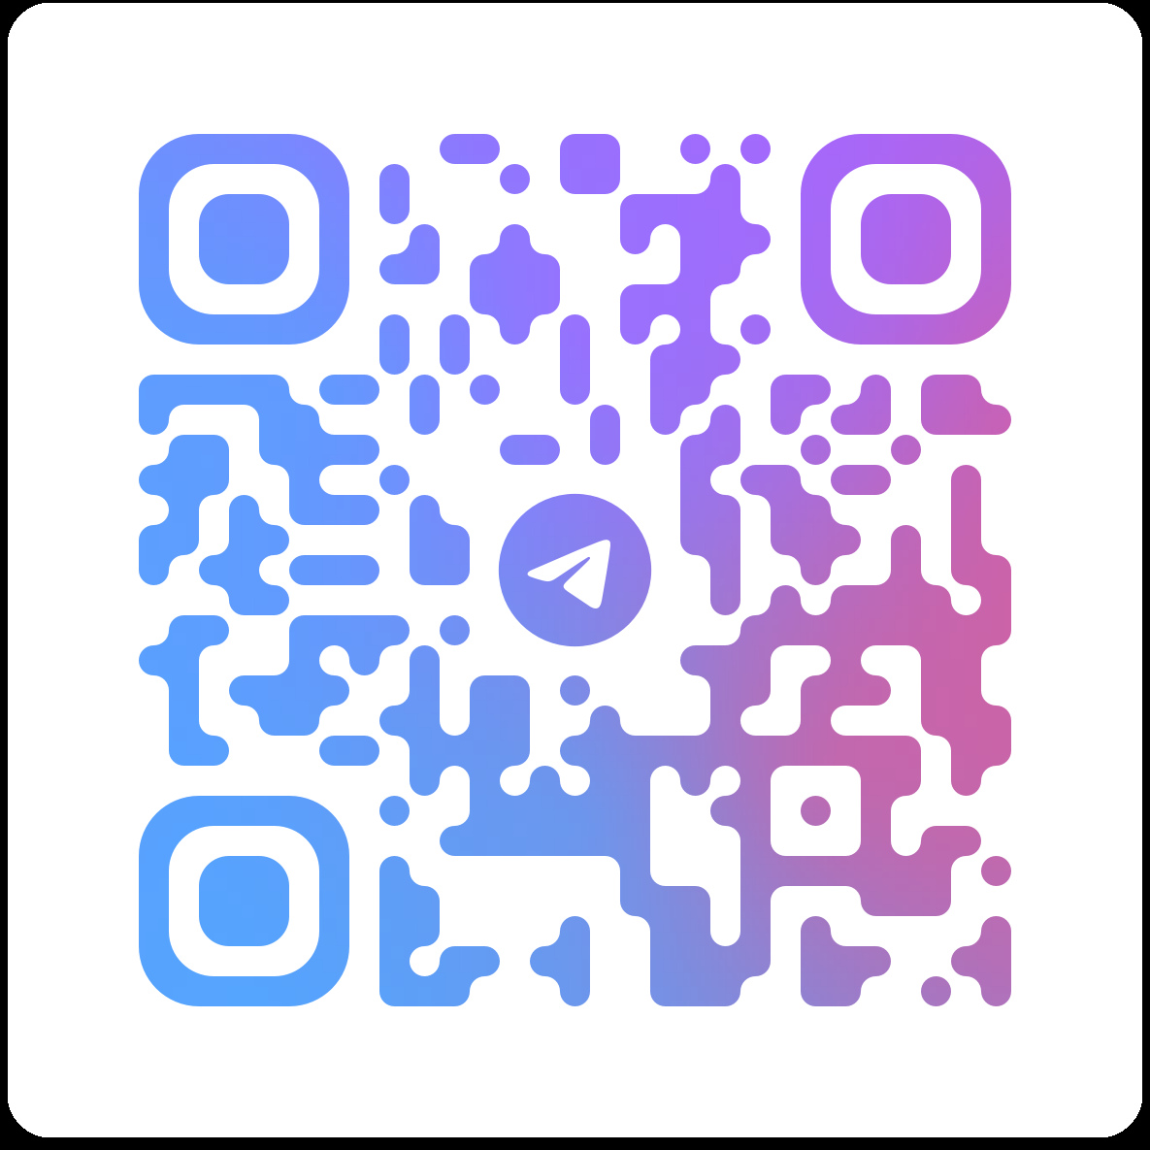
Basic Korean 1
Makhamedova Shirin
Shirin sonsengnim
Office – 206B

Slide 3
Basic Korean 1
Midterm exam - 30% (다시 보기 x) / week-7
Final exam - 30% (다시 보기 x) / week-15
Attendance - 10 % (4 absence = F)
Assignment – 10% (speaking homework)
Quiz – 10% / week - 9
Others – 10%

Slide 4
Others – 10%
Notebook & Class Notes – 5%
Students are required to keep a well-organized notebook with class notes.
The notebook will be checked and evaluated during the course.
2. Class Participation – 5%
Active participation in class and group activities is expected.
−2 points for each violation:
  Sleeping during class
  Leaving the classroom without permission
  Using a mobile phone during class
  Engaging in unnecessary conversations
  Not participating in group activities

Slide 5
Grading System (Relative Grading)
Grade | Score Range
A+ / A 20% | 85–100%
B+ / B 30% | 70–84%
C+ / C 30% | 50–69%
D+ /D 20% | 30–49%
F | 0–29%

Slide 6
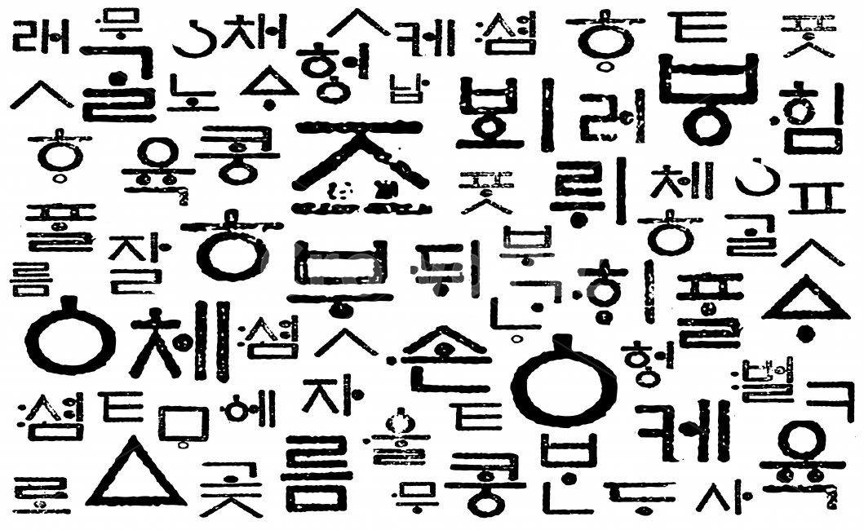
훈민전음 [Hunminjonim]
“Odamlarga to’g’ri talaffuz qilish uchun ko’rsatma”

Slide 7
Koreys alfaviti
24
Harf

Slide 8
Koreys tili
10 unli
14 undosh
11 diftonglar
5 juft undoshlar

Slide 9
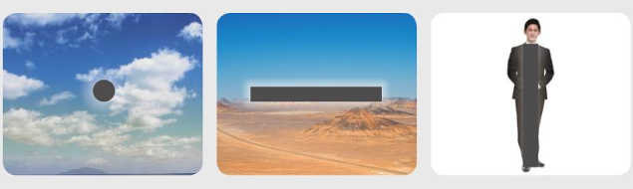
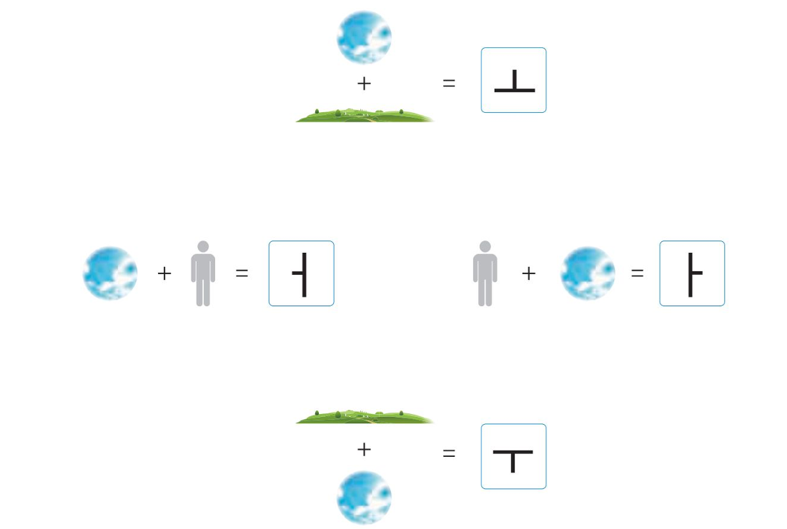
하늘 – xanil(osmon)
땅 – ttang(yer)
사람 – saram(odam)

Slide 11
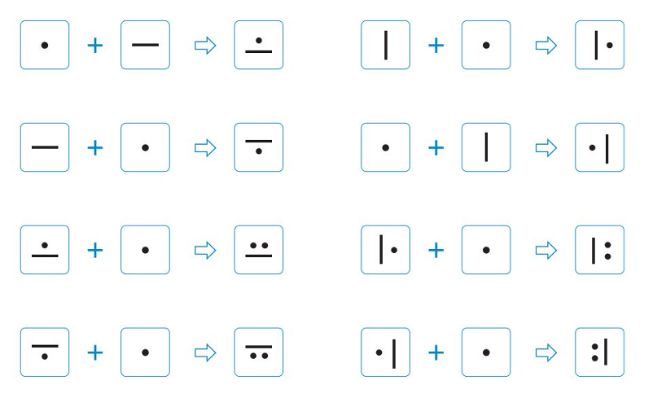

Slide 12
Oddiy unlilar
모음 [моым]
ㅏ
ㅑ
ㅓ
ㅕ
ㅗ
ㅛ
ㅜ
ㅠ
ㅡ
ㅣ

Slide 13
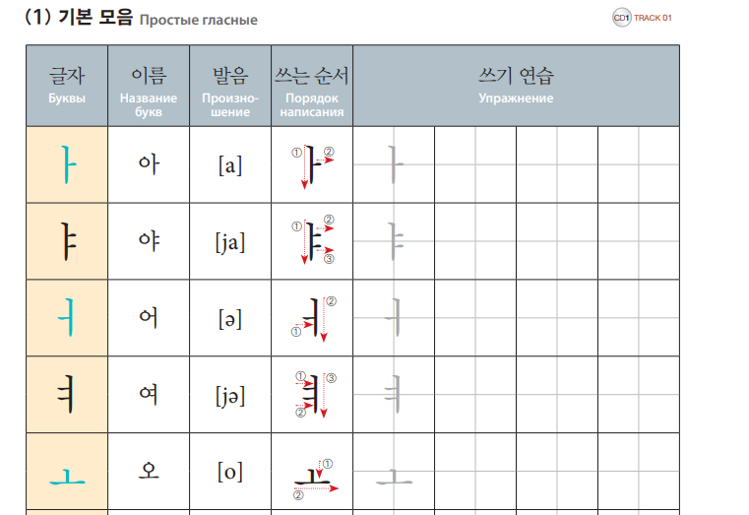

Slide 14
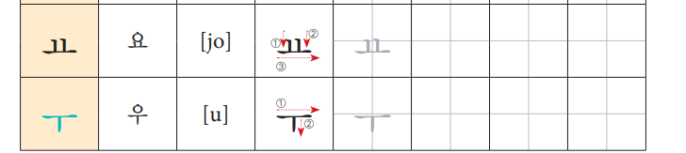
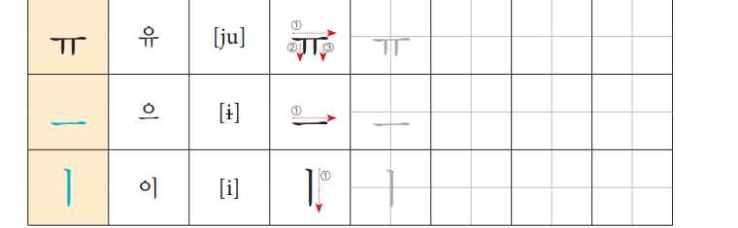

Slide 15
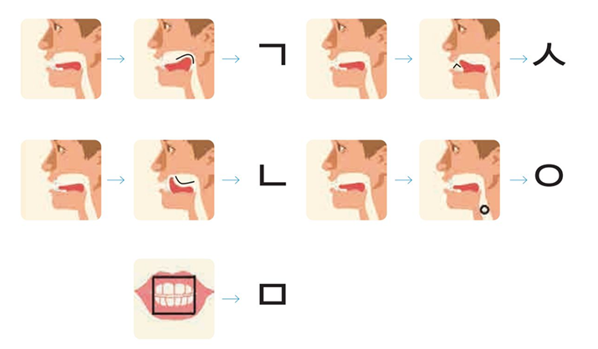
Undosh harflarni kelib chiqishi

Slide 16
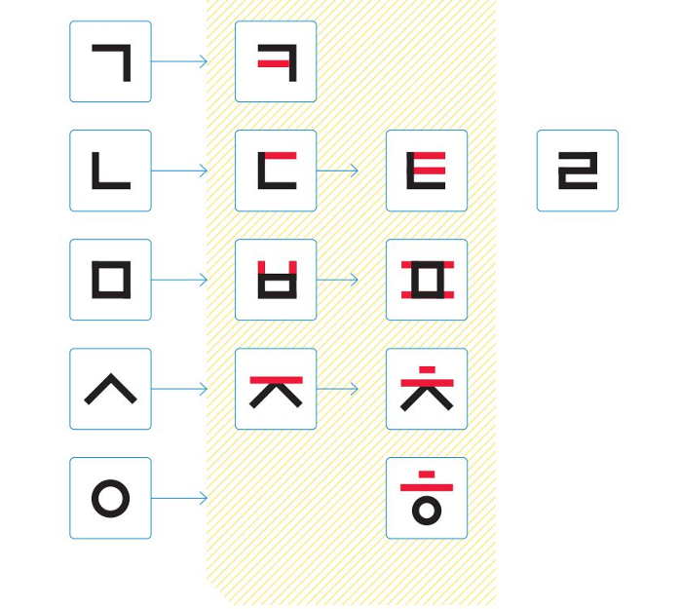

Slide 17
Oddiy undoshlar 자음[чаым]
ㄱ
ㅁ
ㅈ
ㅍ
ㄴ
ㅂ
ㅊ
ㅎ
ㄷ
ㅅ
ㅋ
ㄹ
ㅇ
ㅌ

Slide 18
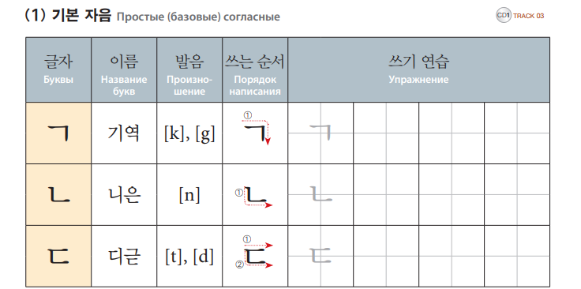
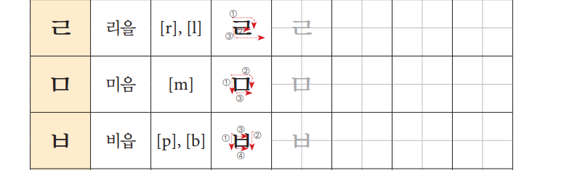

Slide 19
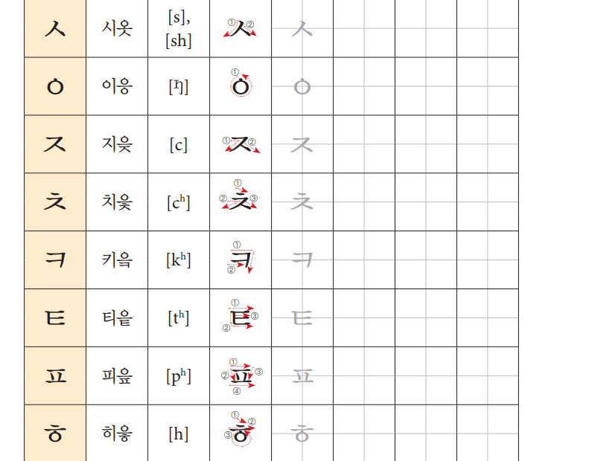

Slide 20
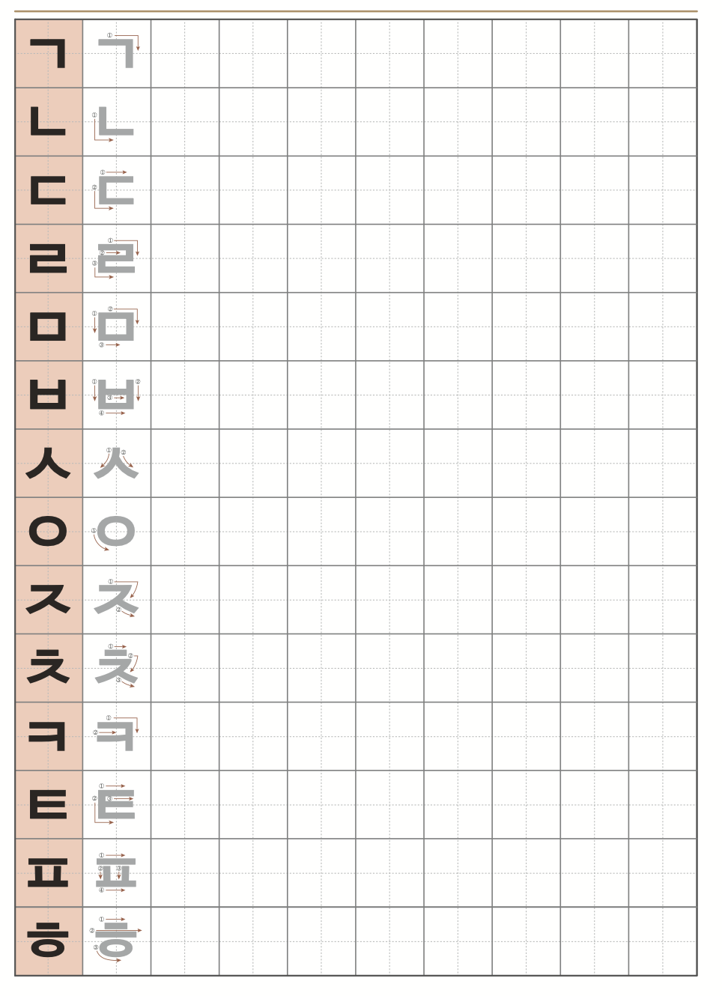

Slide 21
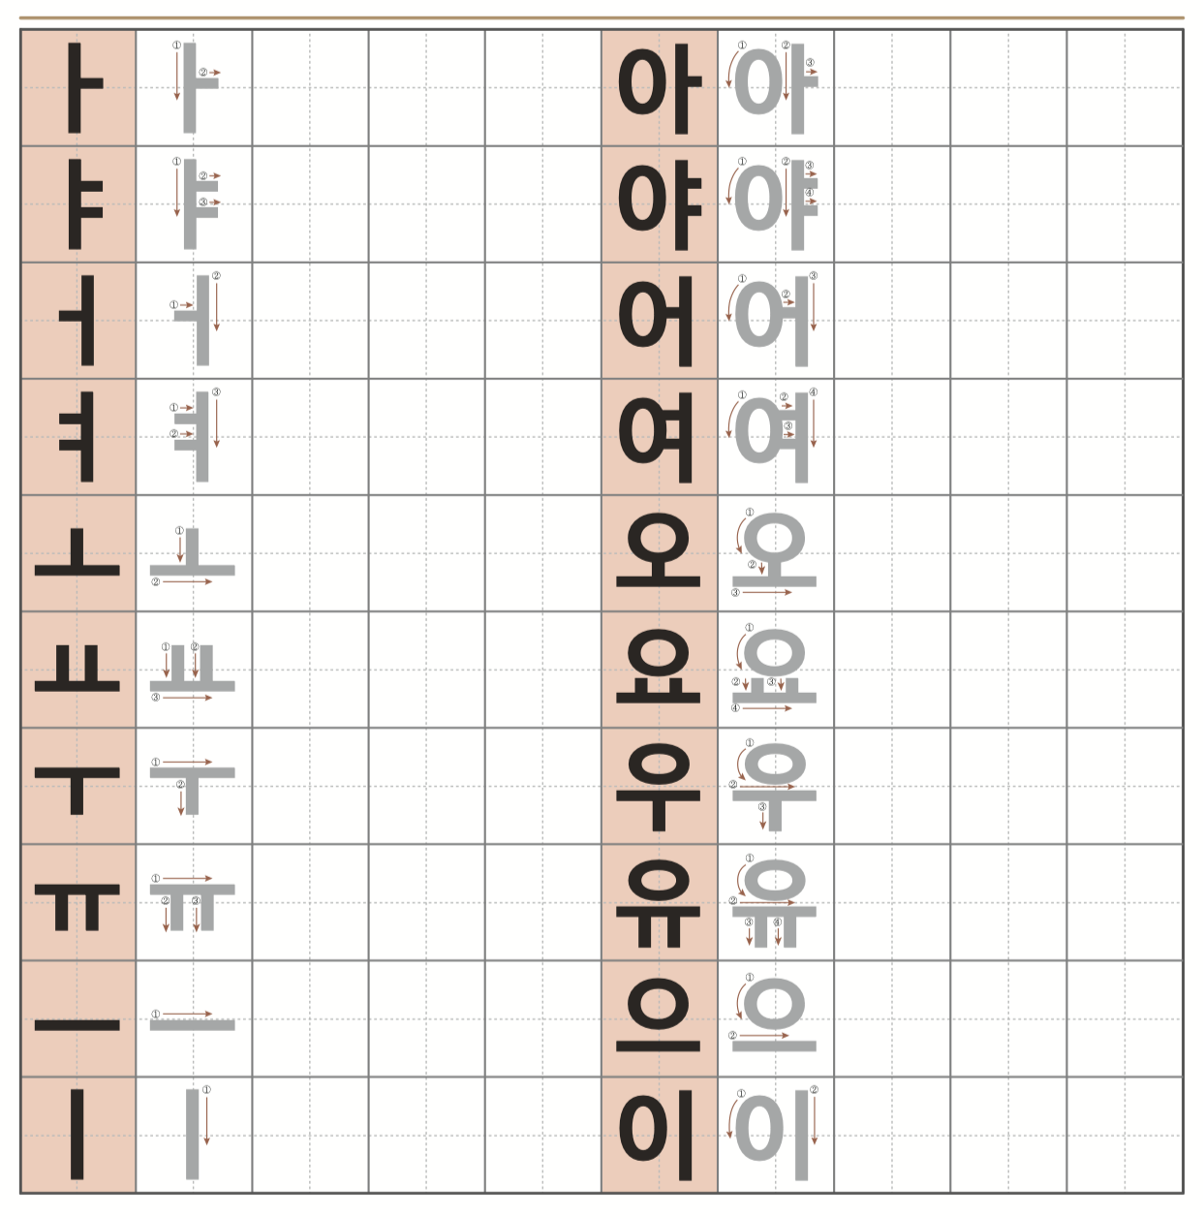

Slide 22


